Slide 1
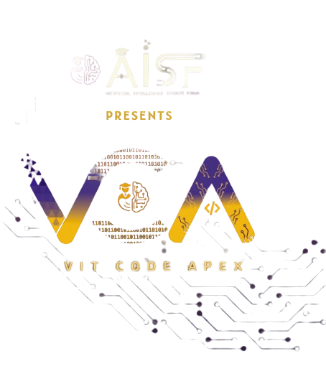

Slide 2

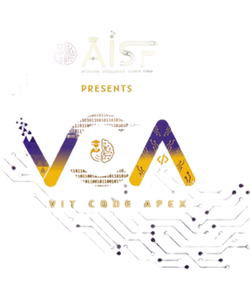
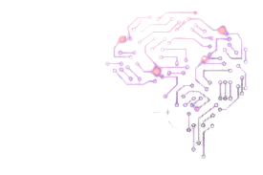
CODE VERSE HACKATHON 2025
Problem Statement Title- (Track 1 – DIATDRDO – PS1)
Marine fouling, also known as biofouling, refers to the undesirable accumulation of microorganisms, plants, algae, and animals on submerged surfaces. This phenomenon occurs in marine environments and impacts various Indian navy critical structures, particularly ships, offshore platforms, and other submerged infrastructure. Fouling can lead to significant operational and economic problems, including increased drag, reduced speed, higher fuel consumption, and potential introduction of invasive species. Design and develop an end-to-end intelligent image based solution that can classify the detected fouling species and the density of fouling on the surface.
Team Name- Team AlgoKnight
Team Members-
Atharva Ralegankar | Kiran Rokade | Shubham Bagul
ralegankaratharva@gmail.com +91 9373970104 | rokadekiran533@gmail.com +91 7385996725 | Shubhamrbagul04@gmail.com +91 9028534557

Slide 3
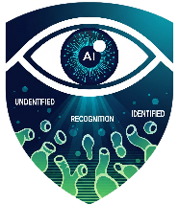
IDEA TITLE
FOULING GUARD AI An Intelligent Solution for Naval Biofouling Our solution, Project Fouling Guard AI, is an end-to-end intelligent platform that operates on a simple three-step principle: Capture, Analyze, and Act. 1. Capture: We provide flexible methods to acquire hull images, including a unique remote option for hard-to-reach areas. 2. Analyze: Our specialized AI instantly classifies the 11 most critical fouling species in Indian waters and calculates their density. 3. Act: We deliver actionable intelligence through a comprehensive dashboard, featuring 3D visualizations, predictive analytics, AR overlays, and an interactive AI assistant to turn data into immediate decisions. | Check Live Demo: https://foulingguard.vercel.app 💡 First-of-its-Kind Indian Species Model: This is the first dedicated ML model trained specifically on a custom dataset of biofouling species found in Indian maritime waters. Unlike generic global models, our solution provides unparalleled accuracy and relevance for the Indian Navy's specific operational environment. 💡 Predictive Growth Analytics: Our system goes beyond static identification. By analyzing the species and its current density, it forecasts the future growth and spread of the biofouling. This powerful feature allows the Navy to shift from a reactive to a proactive maintenance strategy, optimizing cleaning schedules to intervene before fouling causes significant drag. 💡 Crowdsourced Bio-Hotspot Mapping: By leveraging location data from each scan, our platform builds a live, strategic map showing the prevalence of different fouling species across various maritime routes. 💡 Remote QR-Enabled Capture: The ability to inspect inaccessible areas using any mobile device is a significant practical innovation that sets our solution apart from standard inspection tools. 💡 Integrated AI Assistant: Powered by the Gemini API, our platform includes a conversational assistant. Officers can ask questions in natural language about the report, learn more about a specific species, or request data summaries, creating a dynamic decision-support environment. 💡 Augmented Reality (AR) Visualization: Users can project the 3D fouling model onto the real world using their device, providing an intuitive and immersive understanding of the problem's scale and location. In essence, our platform consolidates multiple cutting-edge capabilities into a single, seamless workflow. By integrating AI-powered species detection with live camera integration for real-time processing, we deliver comprehensive reports that are not just data points, but actionable intelligence for superior maritime maintenance.
How it addresses the problem Instead of a generic global approach, we identified the 11 major fouling species that most frequently impact Indian naval ships. By focusing our AI exclusively on these specific threats, we ensure our data is not just accurate but highly relevant, providing a solution tailor-made to solve the primary challenges faced by the Indian Navy's flee

Slide 4
TECHNICAL APPROACH
Technologies That we are using
Frontend
Backend
Data Gathering
React.js TypeScript | Tailwind CSS Leaflet
Node.js | Express.js
iNaturalist DuckDuckGo Images | GBIF Google Images
DataBase
Model
MongoDB
Numpy Pandas Matplotlib | Scipy SciKit Learn Pytorch

Slide 5
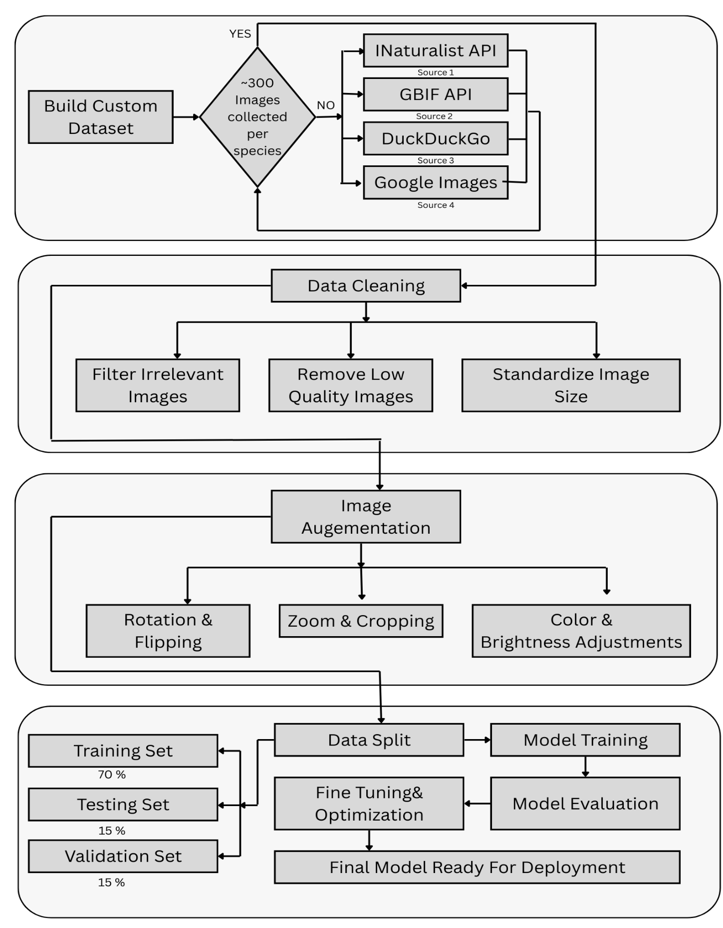
TECHNICAL APPROACH
Phase 1: Custom Dataset Creation This phase addresses the main challenge: the lack of a relevant dataset for Indian marine species. The Problem: We couldn't find a ready-made dataset that was accurate for the specific species found on Indian naval ships. Our Solution: We built our own custom dataset from four different sources to ensure quality and relevance. Source 1 & 2: We used public scientific APIs from iNaturalist and GBIF to collect high-quality, verified images. Source 3 & 4: We supplemented these with scraping from DuckDuckGo and Google Search to reach our target of around 300 images per species. Phase 2: Data Pre-processing & Augmentation Once the data was collected, we meticulously cleaned and prepared it to make our model as accurate as possible. Data Cleaning: We filtered out irrelevant and low-quality images to ensure our model only trained on useful data. We also standardized the image sizes. Image Augmentation: To make our model more robust and prevent overfitting, we created new training images by applying various techniques like rotation, flipping, zooming, and adjusting color and brightness. Phase 3: Model Development & Training This is where our custom dataset and cleaned data come to life, as we build and refine the final AI model. Data Split: We split our dataset into three parts: a training set to teach the model, a validation set to tune it, and a testing set to evaluate its final performance. Model Training & Evaluation: We trained our model on the data and then ran a series of evaluations. Optimization: Based on the results, we fine-tuned our model's parameters until we achieved the highest possible accuracy, resulting in a robust, reliable final model ready for deployment.
Fig 1: Custom Model Preparation

Slide 6
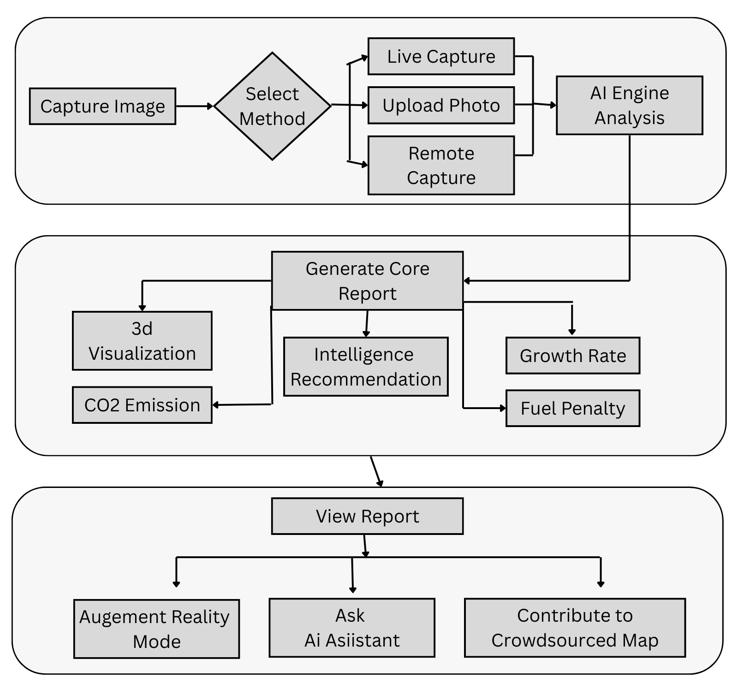
TECHNICAL APPROACH
1. Image Capture This block shows how the user interacts with our system to get an image of the ship’s hull. We've designed multiple ways to make this process easy and practical. Live Capture: Use a device's camera to take a real-time photo of the submerged surface. Upload Photo: Simply upload an image from a device's gallery. Remote Capture: Scan a QR code to securely capture images from a separate device, which is perfect for hard-to-reach areas. 2. AI Engine Analysis This is the core of our system, where the intelligence lives. The AI analyzes the image and generates a comprehensive report with multiple insights. AI Analysis: The uploaded image is processed by our AI model to identify the specific species present and calculate the density of the fouling. Core Report: The system then generates a detailed report that includes: 3D Visualization: A digital model of the fouled area. Intelligent Recommendations: Suggested cleaning methods for the detected species. Predict Growth Rate: A forecast of how quickly the fouling will spread. Calculate CO2 Emission: An estimate of the carbon emissions caused by the increased drag. Calculate Fuel Penalty: A direct calculation of the extra fuel costs. AR Mode: An augmented reality view that overlays the analysis onto the real-world surface. 3. User Experience & Ecosystem This block highlights the features that make our platform user-friendly and collaborative. View Report: The user can access the full report with all its features and insights. Interact with AI Assistant: Ask questions about the report or fouling in general using our integrated AI assistant. Contribute to Crowdsourced Map: The data from each analysis helps build a live map showing where and when different fouling species are found, creating a shared intelligence network.
Fig 2: Platform Working & Features

Slide 7
FEASIBILITY AND VIABILITY
Analysis of the feasibility of the idea Targeted ML Approach: Instead of tackling all 50+ global species, we are focusing on the 11 key biofouling categories identified by IIT Bombay as most relevant to the Indian Navy. This makes data collection and model training highly focused and manageable. Proven Data Sourcing Strategy: We have a multi-tiered plan for dataset creation, using reliable scientific APIs like iNaturalist and GBIF, supplemented by targeted web scraping. This ensures we can build a foundational dataset rapidly. Leveraging Existing Technologies: Our architecture relies on robust and accessible technologies. We will use well-documented computer vision libraries, the Gemini API for the AI assistant, and standard mobile development frameworks, which significantly reduces development risk. MVP-Focused Scope: The project is scoped for a successful hackathon MVP. The core functionality—image capture, species classification, and density analysis—is our primary goal, ensuring we deliver a working prototype.
Potential challenges and risks Data Availability: Finding a sufficient number of high-quality images for some of the rarer, Indian-specific fouling species can be a significant challenge, potentially creating an imbalanced dataset. Data Quality: The quality and consistency of images sourced from the web under time constraints is a risk. Poor lighting or incorrect labels could impact model accuracy. Model Accuracy: Differentiating between visually similar species and accurately identifying mixed fouling with a rapidly trained model can be challenging. Integration Complexity: Integrating multiple advanced features like AR, 3D visualization, and a real-time AI assistant within a short timeframe is ambitious. | Strategies for overcoming these challenges Multi-Source Data Sourcing: To combat data scarcity, we employ a multi-tiered sourcing strategy. We prioritize scientific APIs like iNaturalist and GBIF, but if image targets aren't met, we shift to targeted web and image search scraping to ensure each category has sufficient data. Data Risk Mitigation: We will implement a rigorous data cleaning and pre-processing pipeline, along with data augmentation techniques (e.g., rotation, brightness adjustment) to improve the model's robustness. Accelerated Model Training: We will employ Transfer Learning using a pre-trained model like MobileNetV2. This allows us to achieve high accuracy with a smaller, custom dataset. Modular & Agile Development: We will build the system in a modular fashion. Our top priority is perfecting the core classification engine, ensuring a functional core product is ready for demonstration.

Slide 8
IMPACT AND BENEFITS
Potential impact of the solution Optimizes Defense Budget Allocation: Drastically cuts fuel and maintenance expenditures, freeing up significant capital that can be reallocated to modernization, R&D, and other critical defense priorities. Revolutionizes Naval Maintenance: Shifts naval maintenance from a reactive, calendar-based schedule to an intelligent, predictive model, increasing asset availability and operational lifespan. Enhances Maritime Security: Creates a unique environmental intelligence layer through a crowdsourced map, enhancing maritime security and domain awareness by tracking marine ecosystem changes. Unifies Digital Decision-Making: Establishes a seamless digital ecosystem that empowers personnel at all levels with actionable intelligence, from tactical inspections to strategic command decisions. Drives Indigenous Self-Reliance: Champions the "Aatmanirbhar Bharat" initiative by creating a sovereign AI capability for naval maintenance, reducing dependence on foreign technology. Creates a National Scientific Asset: The collected data becomes a valuable national asset for scientific research, positioning the Navy as a key contributor to marine biology and climate science. Upskills the Naval Workforce: Acts as a digital transformation tool, training personnel in the use of AI, data analytics, and AR, creating a more technologically advanced and future-ready force while enhancing operational safety. |  | Benefits of the solution Significant Fuel & Cost Reduction 💰 By enabling predictive, perfectly timed cleanings based on the actual condition of the hull, the solution directly reduces hydrodynamic drag. This leads to major reductions in fuel consumption and lowers overall operational costs by preventing severe fouling and extending the life of expensive anti-fouling coatings. Increased Mission Readiness & Asset Availability 🚢 The system ensures naval vessels operate at peak performance with optimal speed and maneuverability. By shifting from reactive to proactive maintenance, it significantly reduces unexpected downtime and the need for extensive dry-docking, maximizing the operational availability of the fleet. Superior Threat Identification Accuracy 🎯 Unlike generic global models, your solution uses an AI model trained specifically on the 11 key fouling species found in Indian waters. This delivers an unparalleled degree of accuracy and relevance, providing the Indian Navy with tactical intelligence tailored to its specific area of operations. Enhanced Personnel Safety ✅ Features like the remote QR-based image capture allow for the inspection of confined, submerged, or hard-to-reach areas of a ship's hull without putting divers or crew in potentially hazardous situations. This makes the data collection process not only more comprehensive but also significantly safer. Accelerated Decision-Making & Workforce Training 🧠 The integrated AI Assistant empowers personnel to get instant answers about complex reports. Furthermore, the Augmented Reality (AR) visualization acts as a powerful training tool, helping new crew members quickly learn to identify species and understand fouling severity in a real-world context.

